Slide 1
E-Commmerce Sales Trends
By:
Douglas High, Eric Viera, Jeffrey Hoffman,
Joonil Kim, and Melissa Torres

Slide 2


Objective:
E-Commerce sales trend over the past 10 years in the following countries:
United States
Canada
South Korea
China
Germany
Covid-19 Impact on E-Commerce

Slide 3

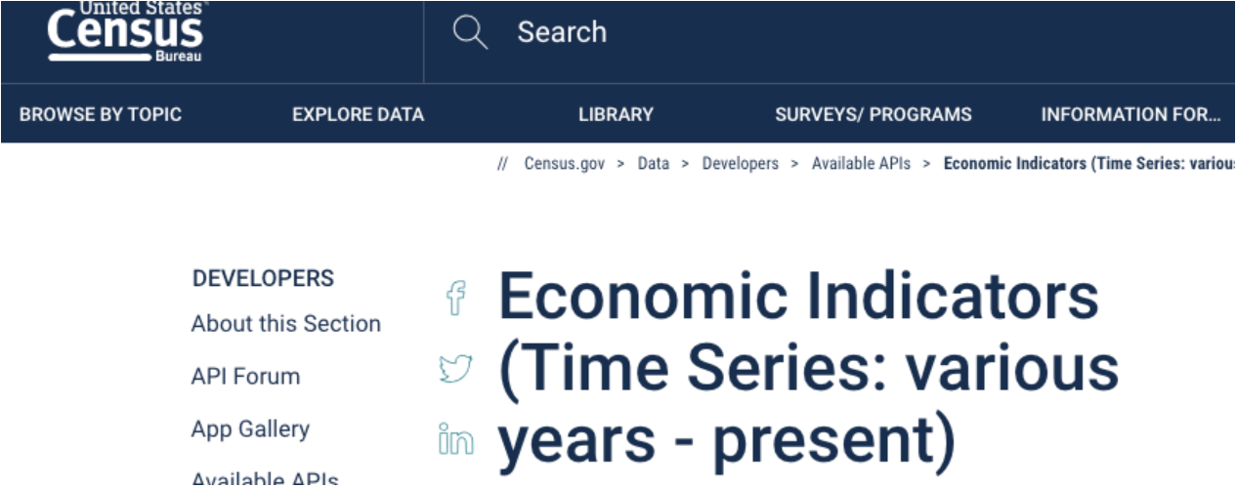


Data Sources:
*United States Census Bureau (https://www.census.gov/)
Canada Open Government (https://open.canada.ca/)
Korean Statistical Information Service (https://kosis.kr/eng/)
*Covid19 (https://covid19api.com)
Statista (https://statista.com)

Slide 4
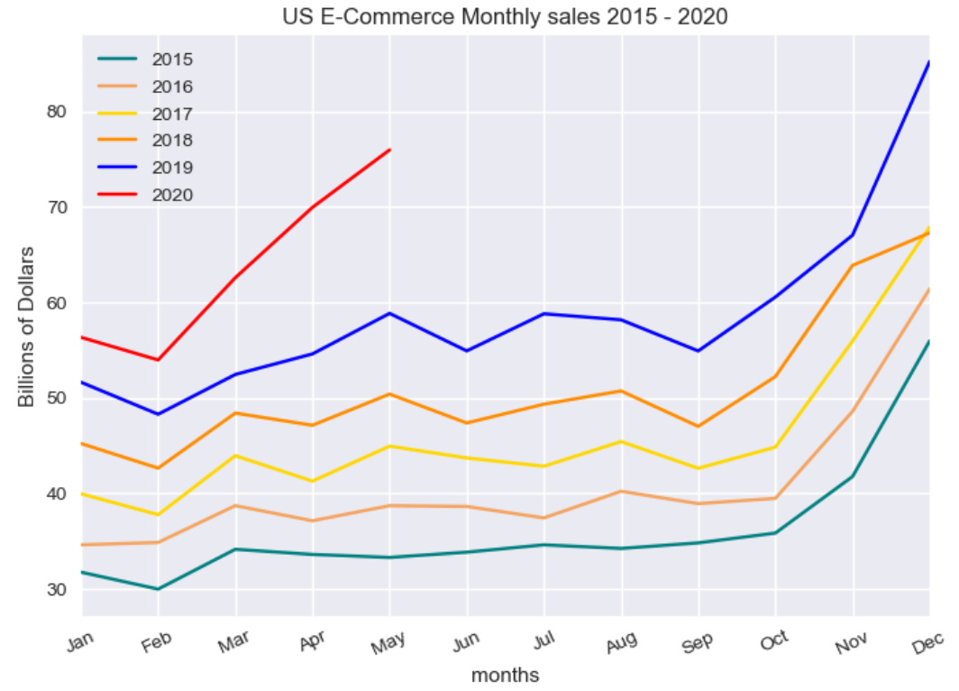
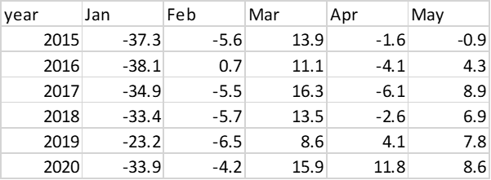
US E-Commerce Monthly Sales
Historically, March is the first month to show an increase in monthly sales each year.
April sales generally drop off, though in 2019 there was a slight increase.
May there has been a consistent increase.
However, for 2020, due to the COVID situation and lockdown starting mid-March, E-commerce has shown a considerably steeper increase in March sales than normal, followed by increased April sales, rather than the norm of a drop.

Slide 5
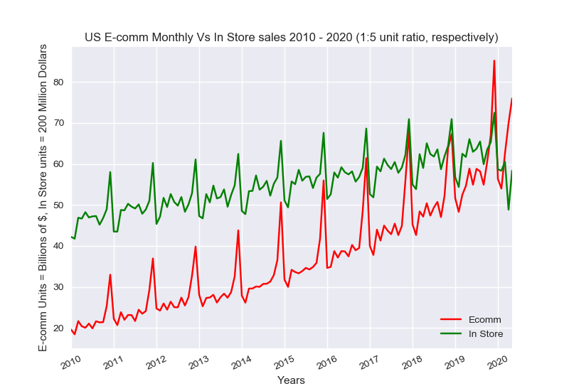
U.S. E-Commerce vs In-Store Sales
In-Store and E-Comm. retail sales have steadily increased over the past 10 years.
E-Comm. Sales shows a larger rate of change in the December Peaks than the average throughout the year.
Fairly noticeable is a consistent monthly change from year to year

Slide 6
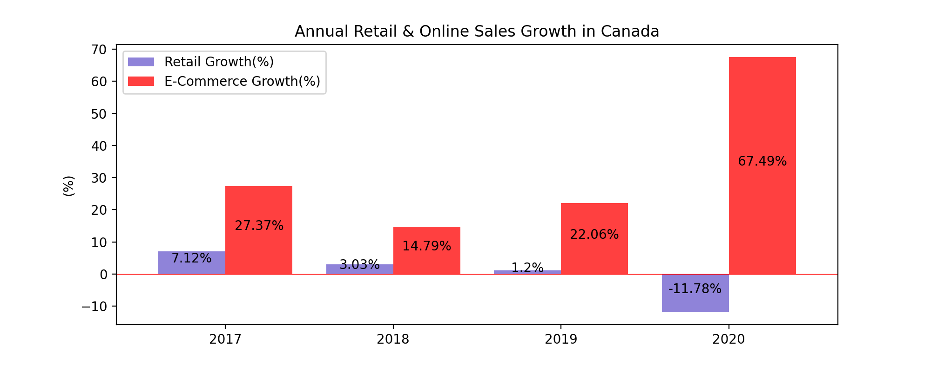
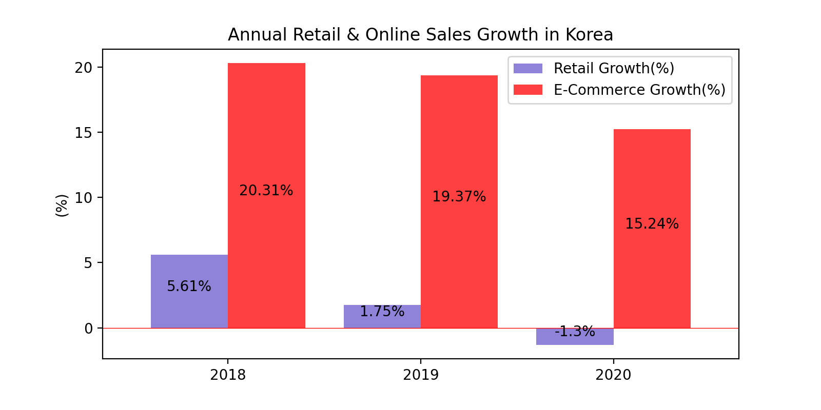
Annual Retail & E-Commerce Sales Growth Rate
E-Commerce sales highly increased in 2020 while overall sales decreased in Canada
In Korea, E-Commerce growth rate has slowed down
※ 2020: Jan - May

Slide 7
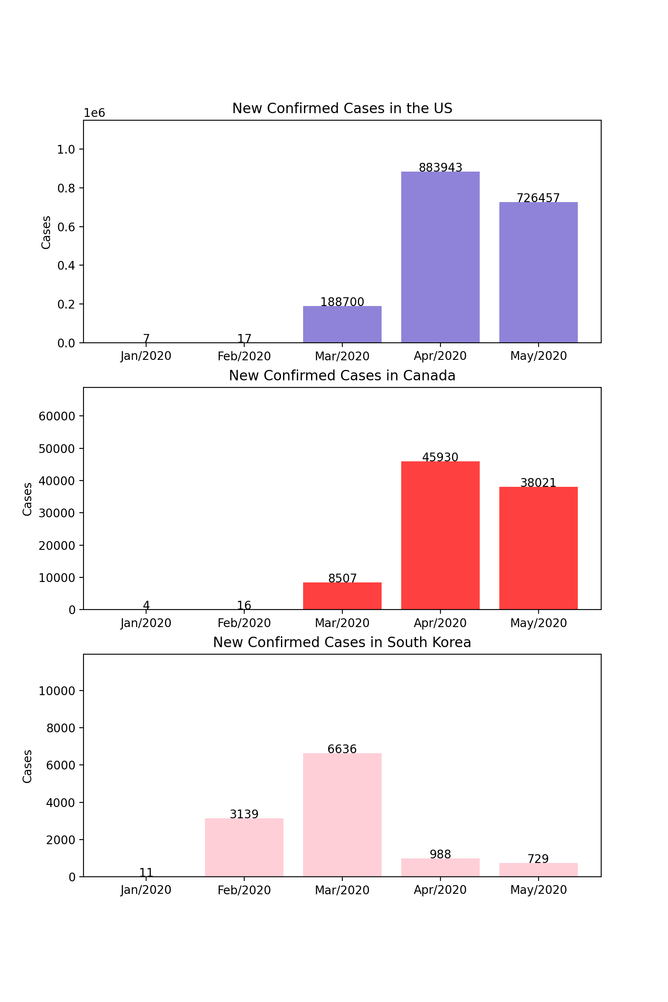
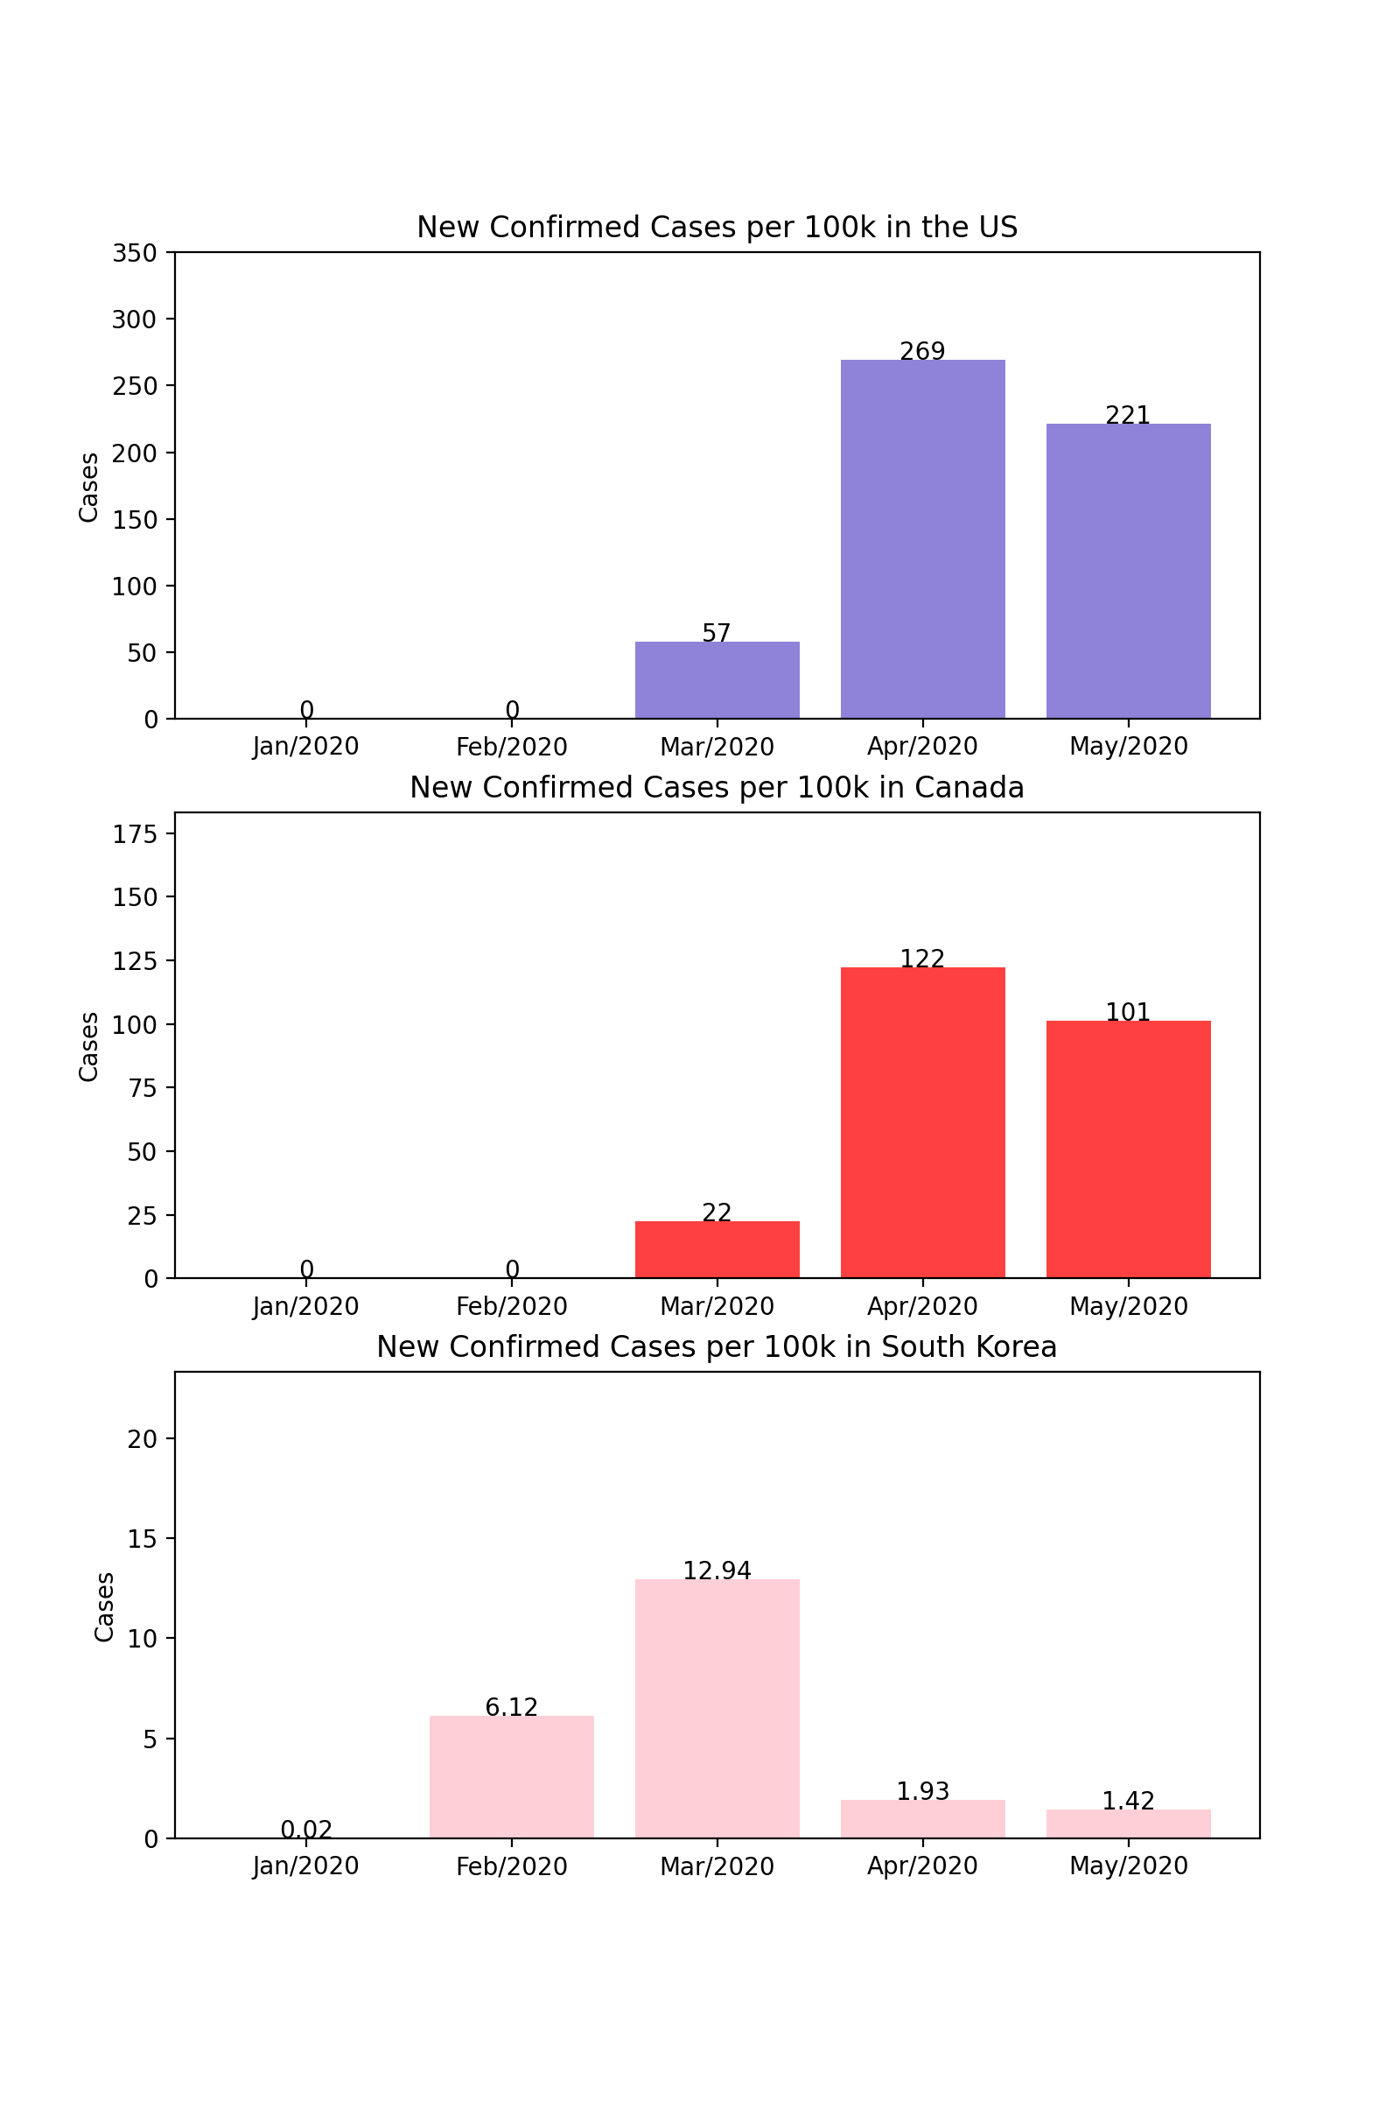
Current Situation in Other Countries

Slide 8
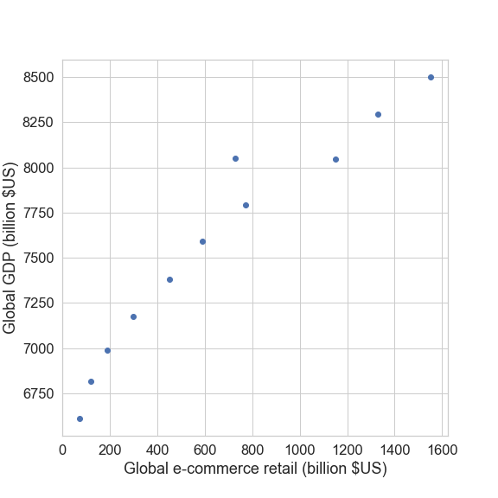
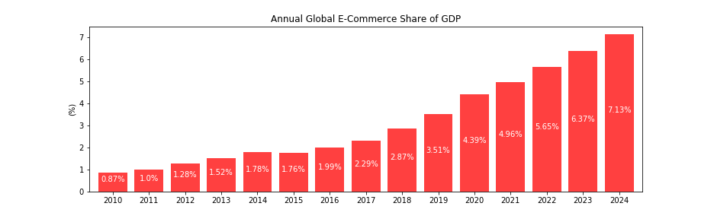
Global: e-Commerce retail vs GDP Share – 2010 – 2024*

Slide 9
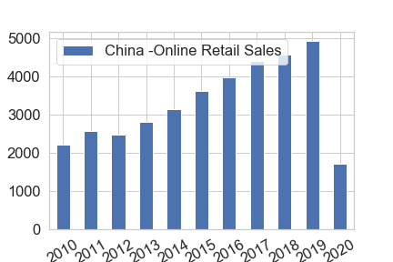
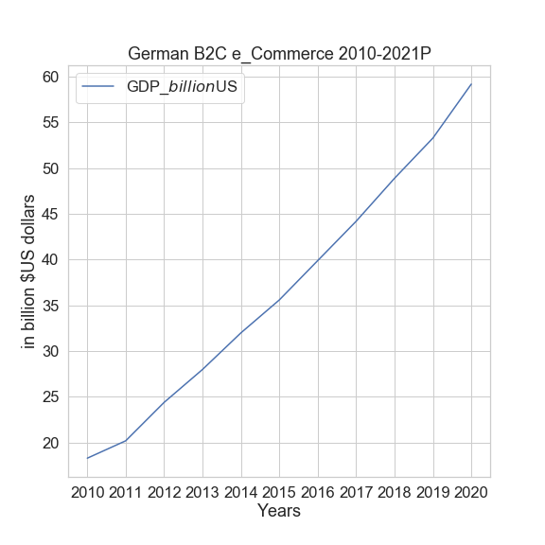
German & China e-Commerce Trends

Slide 10
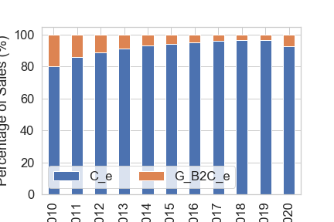
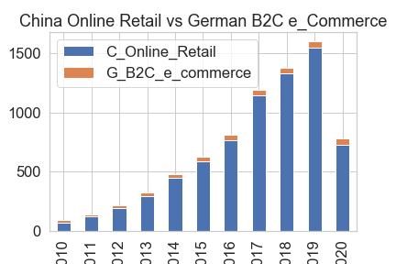
China Online Retail Size vs German B2C e_Commerce markets 2010 - 2020

Slide 11
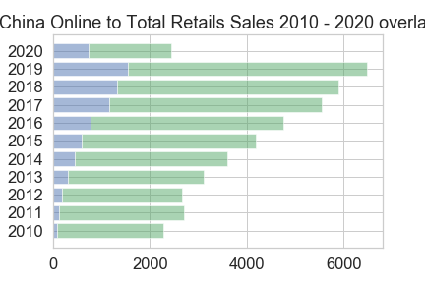
e_Commerce increasing share of total retail China

Slide 12
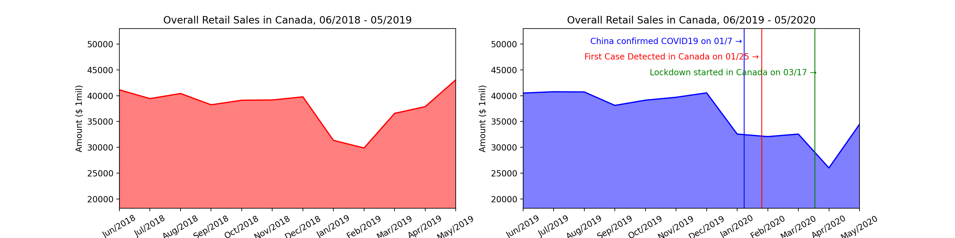
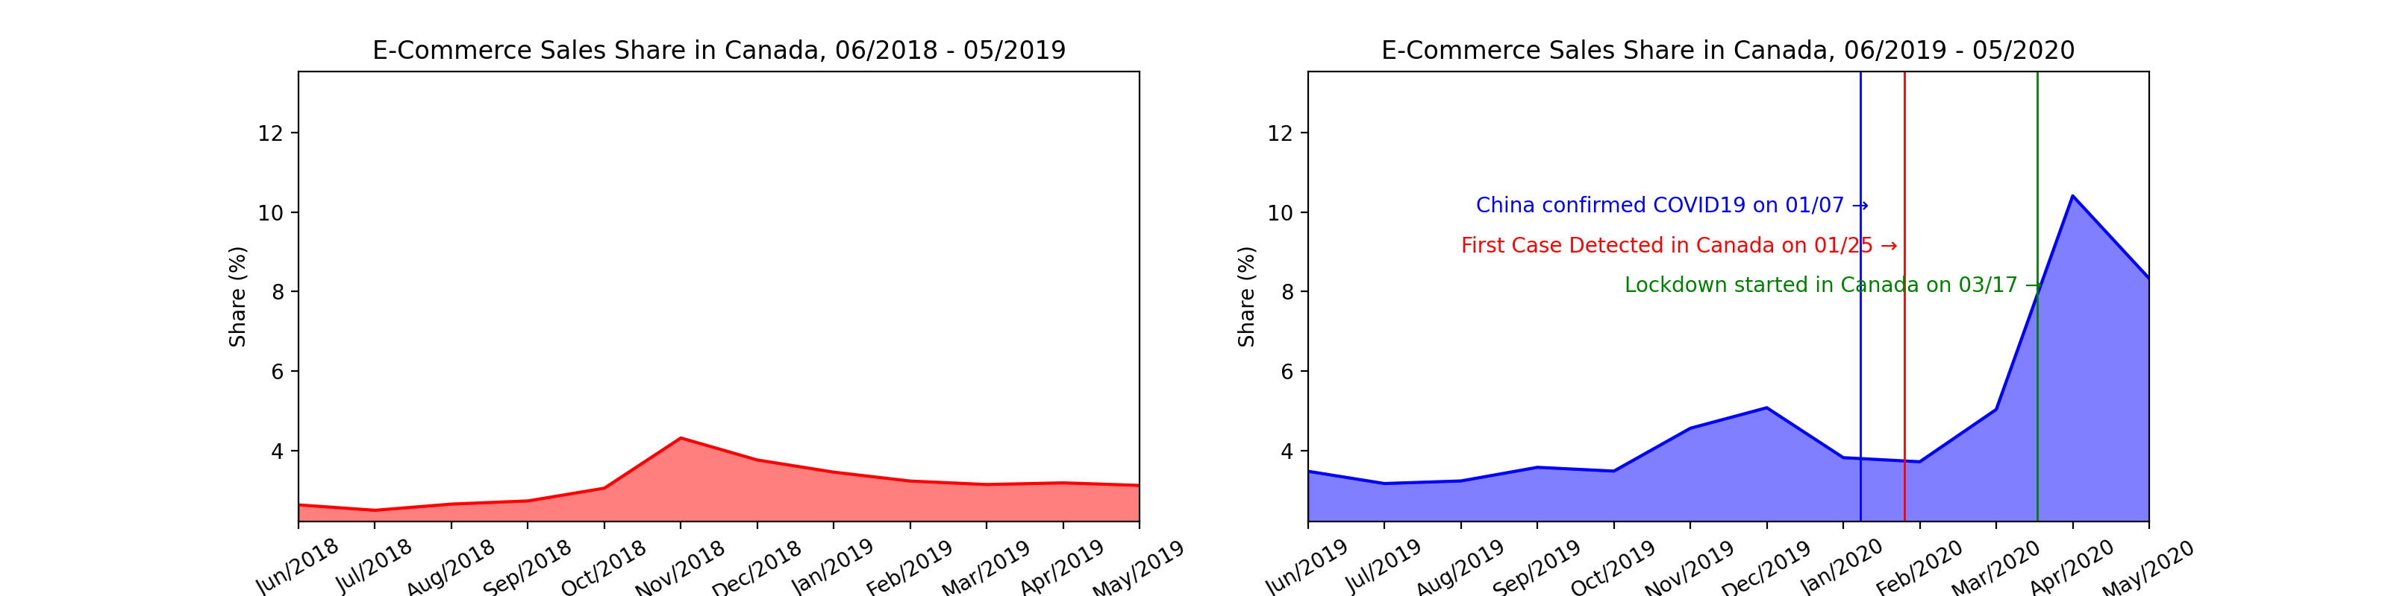
COVID 19 Impact on E-commerce Sales in Canada

Slide 13
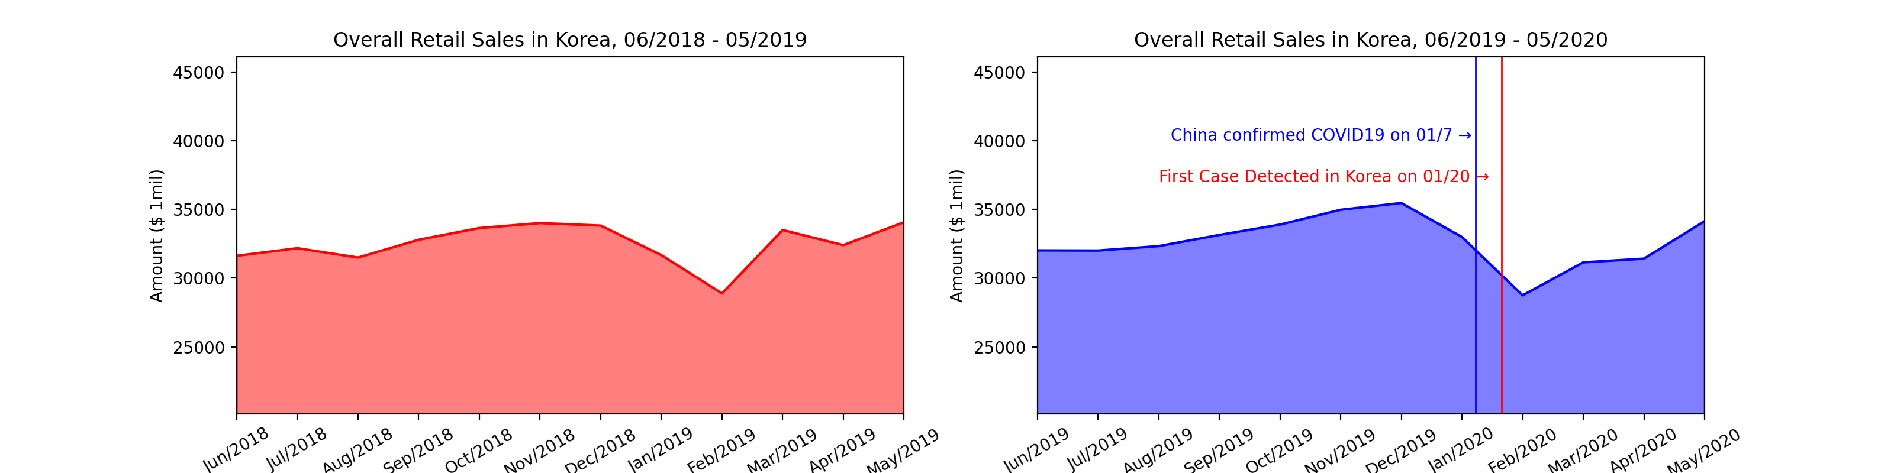
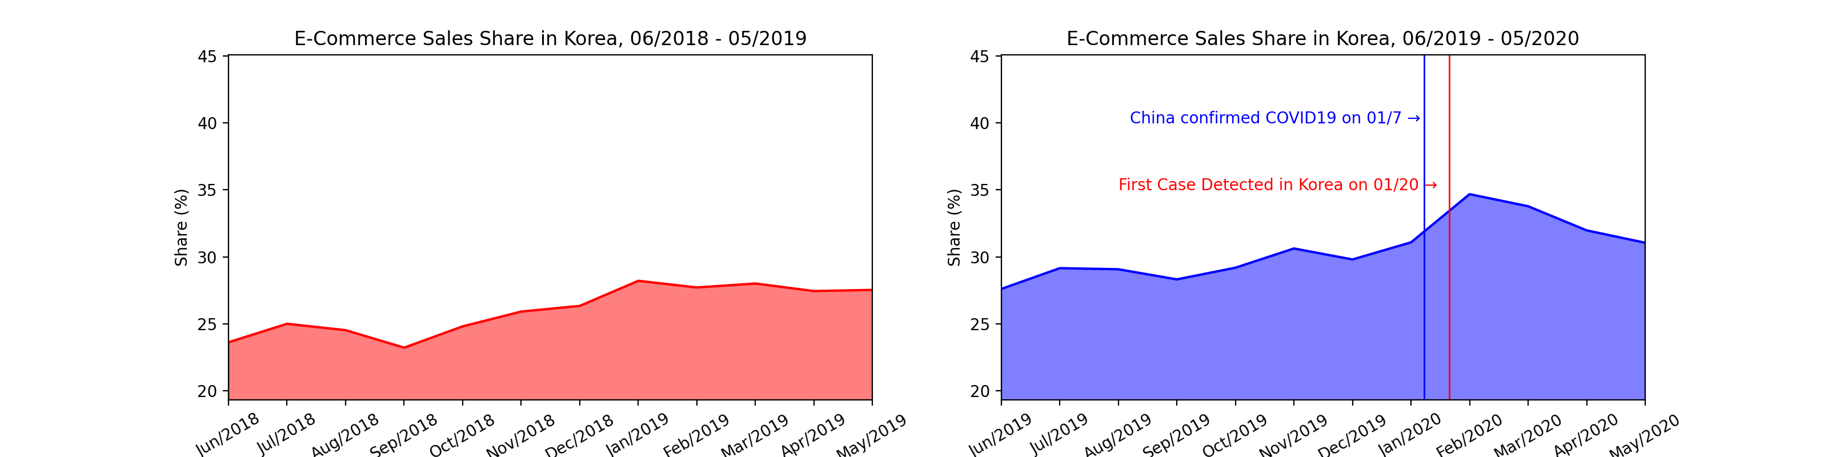
COVID 19 Impact on E-commerce Sales in Korea

Slide 14
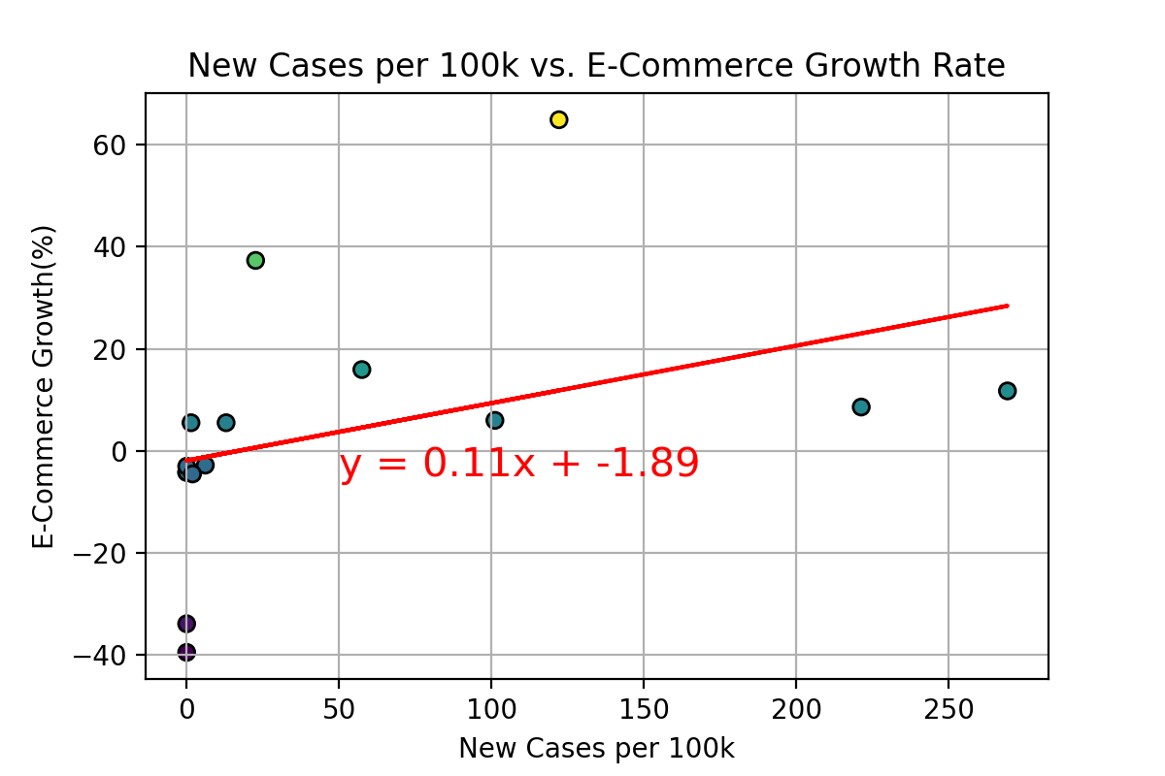
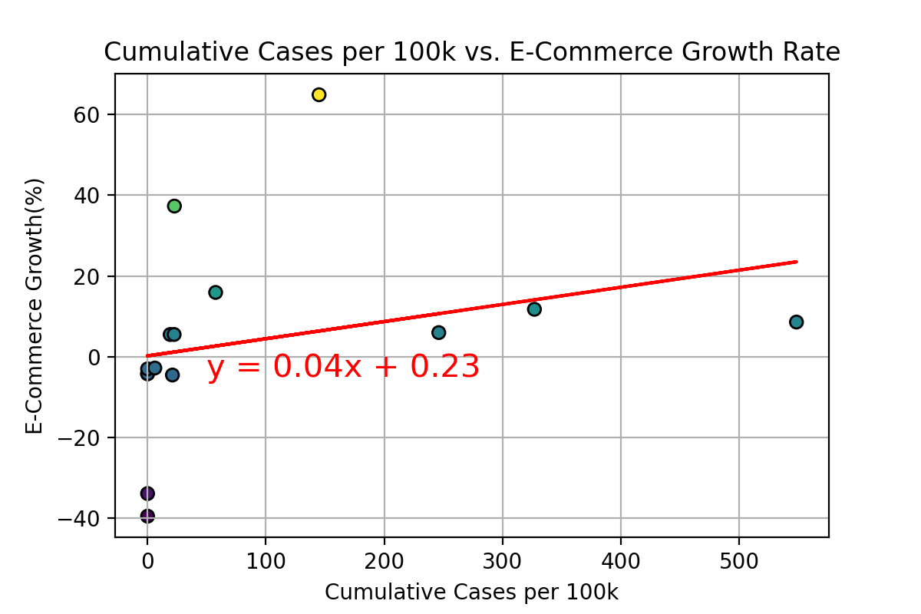
Correlation Between COVID and
E-Commerce Sales
Weak Correlation between COVID cases and E-Commerce Growth Rate
Correlation Coefficient: 0.39
Correlation Coefficient: 0.15

Slide 15
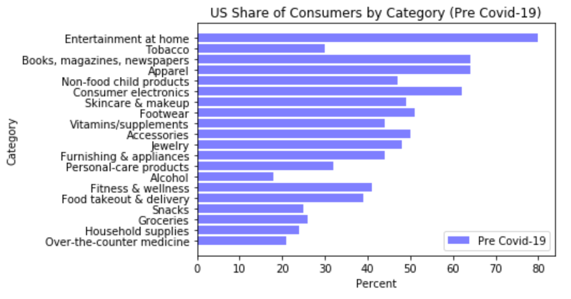
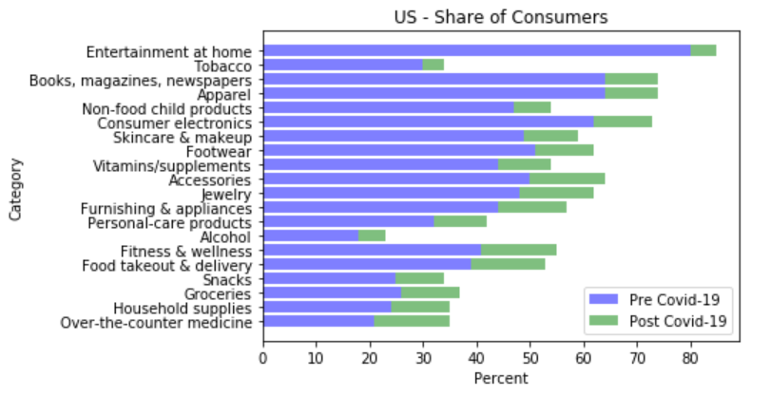
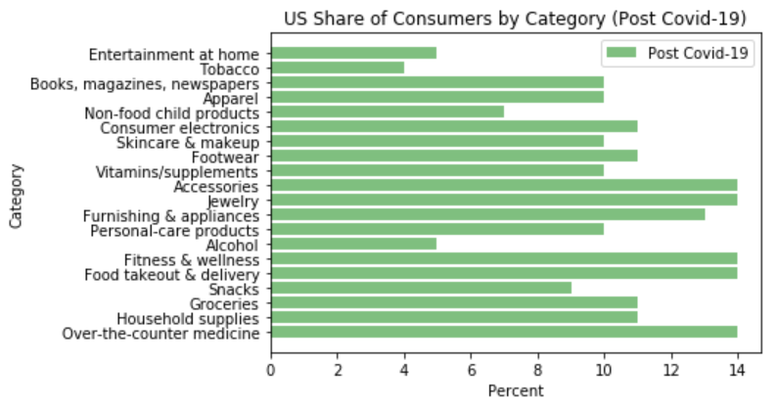
Consumer Behavior Pre and Post-Covid-19

Slide 16
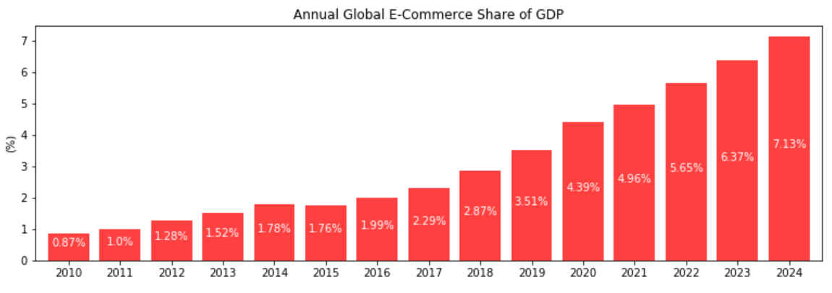
Annual Global E-Commerce Share of GDP

Slide 17
Summary
E-commerce sales in the US follow the same basic annual trends as in store sales but with a steeper growth rate, especially during the holiday season. Even before the COVID, they accounted for nearly 20% of total sales, up from under 10% in 2010.

